Slide 1
Deep Learning
Session 1

Slide 2
Agenda:
1 | Introduction to Deep Learning
2 | Neurons and Perceptrons
3 | Feedforward Neural Networks
4 | Backpropagation and Gradient Descent

Slide 3
Introduction to Deep Learning

Slide 4
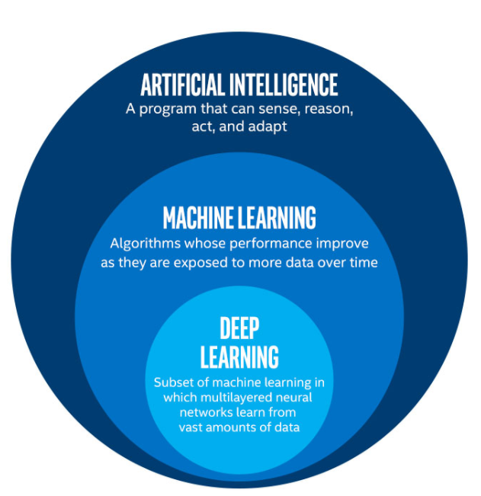
Introduction to Deep Learning
Deep learning is a subset of machine learning that uses multilayered neural networks, called deep neural networks, to simulate the complex decision-making power of the human brain. Some form of deep learning powers most of the artificial intelligence (AI) applications in our lives today

Slide 5
Introduction to Deep Learning
The Difference Between Deep Learning and Machine Learning
The primary distinction between deep learning and machine learning lies in how they execute their tasks.
Machine Learning (ML) often requires manual feature extraction. For example, a data scientist needs to predefine important features for the model to focus on. In contrast, deep learning (DL) automatically learns these features from raw data.
Data Requirements: Deep learning models need a large amount of data to perform well. When the data is small, machine learning tends to outperform deep learning since deep learning requires massive datasets to learn efficiently.
Computational Power: Deep learning algorithms rely on high-end machines and GPUs. This is necessary because the algorithms process enormous amounts of data and perform complex computations across multiple layers of neural networks.

Slide 6
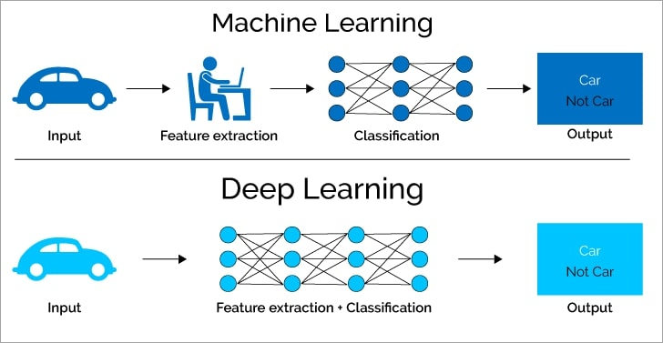
Introduction to Deep Learning
The Difference Between Deep Learning and Machine Learning

Slide 7
Introduction to Deep Learning
How Deep Learning Extracts Features
Traditional machine learning workflows involve a process where data undergoes feature extraction, followed by the task (such as classification or regression). This requires a person to choose which features are most relevant.
In deep learning, feature extraction happens automatically within the layers of the neural network. Each layer in a deep network builds on features learned by previous layers, from low-level patterns to high-level representations.
This capability is a major advantage because it reduces the need for manually developing new feature extractors for every problem. Deep learning can learn these by itself as long as there's enough data.

Slide 8
Introduction to Deep Learning
Why is Deep Learning Gaining Popularity?
While deep learning is not a new concept, it has seen rapid growth recently due to several factors
Big Data: The availability of massive datasets (e.g., images, text, videos) is a key driver of deep learning’s success. Large tech companies like Facebook, Walmart, and YouTube produce vast amounts of data daily, providing the foundation for training powerful deep learning models.

Slide 9
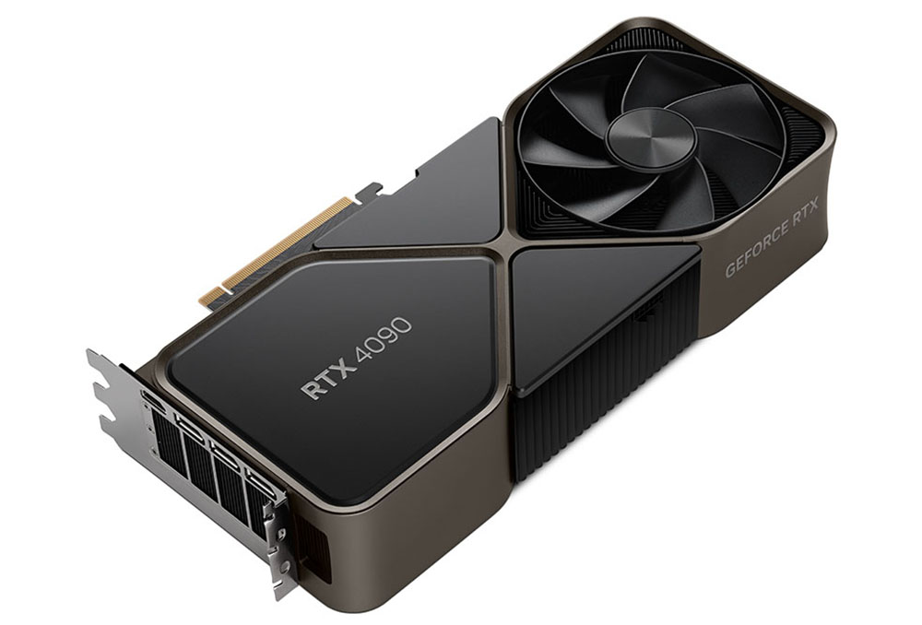
Introduction to Deep Learning
Why is Deep Learning Gaining Popularity?
While deep learning is not a new concept, it has seen rapid growth recently due to several factors
Improved Hardware (GPUs): High-performance GPUs and cloud infrastructure allow deep learning models to process enormous amounts of data efficiently, which wasn’t feasible with earlier hardware technologies.

Slide 10
Introduction to Deep Learning
Why is Deep Learning Gaining Popularity?
While deep learning is not a new concept, it has seen rapid growth recently due to several factors
New Techniques: Advances in algorithms and techniques for training deep networks have made deep learning far more effective than it was a few decades ago.

Slide 11
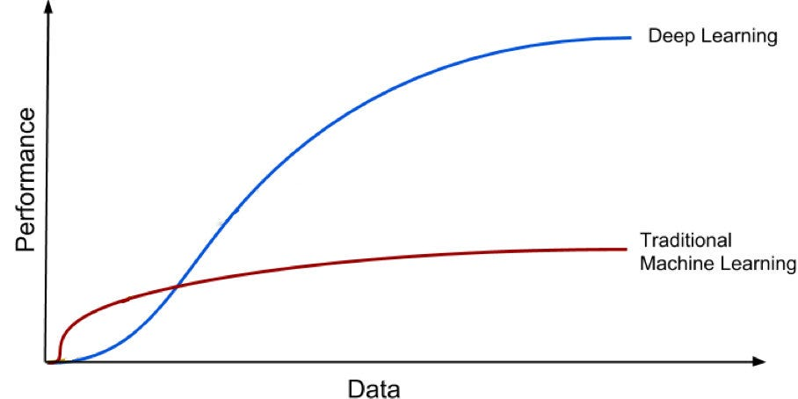
Introduction to Deep Learning
Why Deep Learning?
Machine learning models often reach a performance plateau after a certain point. Even if we increase the amount of data, the model might not find additional patterns or features to improve its performance.

Slide 12
Introduction to Deep Learning
Why Deep Learning?
Deep learning, on the other hand, continues to improve as more data is added. As we construct larger neural networks and expose them to more data, their performance increases significantly.
This scalability with data is one of the major reasons deep learning is thriving in areas like image recognition and natural language processing.

Slide 13
Introduction to Deep Learning
Key Takeaways
1. Deep Learning vs. Machine Learning
Deep learning requires large datasets and high computational power but automatically extracts features.
Machine learning can work well with smaller datasets and requires manual feature extraction.

Slide 14
Introduction to Deep Learning
Key Takeaways
2. Deep Learning's Growth
Driven by big data availability, improved hardware (like GPUs), and advances in algorithms.
3. Why Deep Learning?
It can handle both structured and unstructured data (such as images, videos, and speech).
It scales well with the amount of data, unlike traditional machine learning methods, which may plateau.

Slide 15
Neurons and Perceptrons

Slide 16
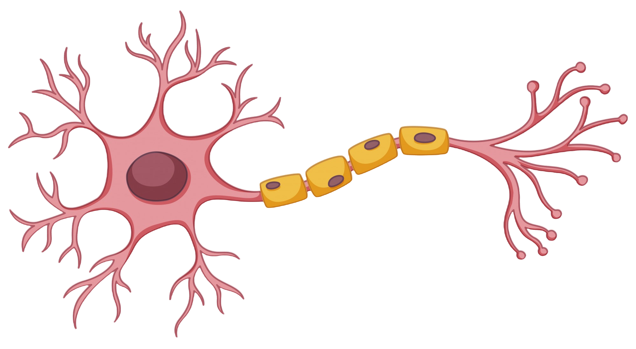
Neurons and Perceptrons
What is a Neuron?
Let’s start by understanding the basic building block of neural networks, the neuron
In biology, a neuron is a cell in the brain that transmits information via electrical and chemical signals. These neurons are interconnected in a complex network and are responsible for all our cognitive functions.

Slide 17
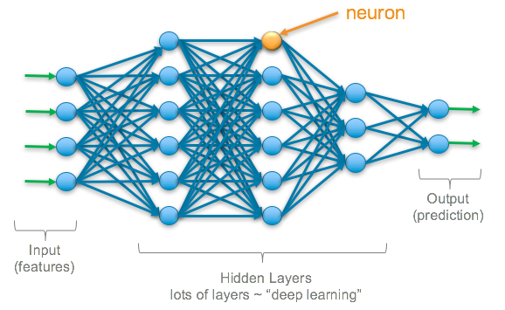
Neurons and Perceptrons
What is a Neuron?
Let’s start by understanding the basic building block of neural networks, the neuron
In artificial neural networks (ANNs), a neuron is a mathematical function that processes input data and produces an output. Artificial neurons are modeled after biological neurons but use mathematical functions to simulate learning behavior.

Slide 18
Neurons and Perceptrons
How an Artificial Neuron Works
An artificial neuron mimics the biological neuron by performing these key steps
1. Inputs (Features)
These are the data points provided to the neuron, often in the form of numbers (e.g., pixels of an image, features of a dataset like height or weight).

Slide 19
Neurons and Perceptrons
How an Artificial Neuron Works
An artificial neuron mimics the biological neuron by performing these key steps
2. Weights
Each input is assigned a weight. Weights determine the importance of each input to the final output. A weight can be positive or negative, depending on whether it amplifies or diminishes the input’s effect.

Slide 20
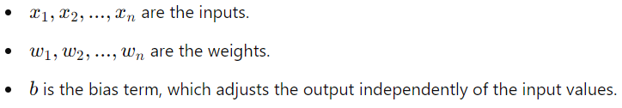
Neurons and Perceptrons
How an Artificial Neuron Works
An artificial neuron mimics the biological neuron by performing these key steps
3. Weighted Sum
The neuron computes a weighted sum of all its inputs. This is done by multiplying each input by its corresponding weight and adding them together.
Mathematically, this is expressed as :
Where :

Slide 21
Neurons and Perceptrons
How an Artificial Neuron Works
An artificial neuron mimics the biological neuron by performing these key steps
4. Bias
The bias term is an additional constant added to the weighted sum. Bias allows the model to shift the activation function, helping it fit the data better.

Slide 22
Neurons and Perceptrons
How an Artificial Neuron Works
An artificial neuron mimics the biological neuron by performing these key steps
5. Activation Function
Once the weighted sum and bias are calculated, the result is passed through an activation function. This function determines whether the neuron should be "activated" (i.e., fire) or not, similar to how a biological neuron decides whether to send a signal.

Slide 23
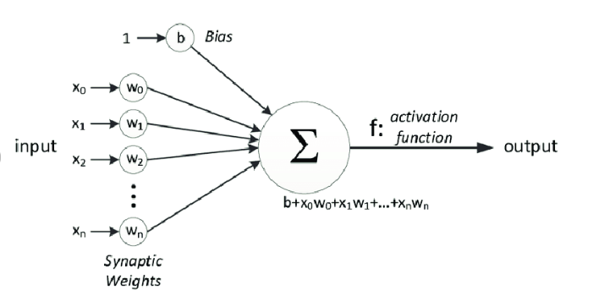
Neurons and Perceptrons
How an Artificial Neuron Works

Slide 24
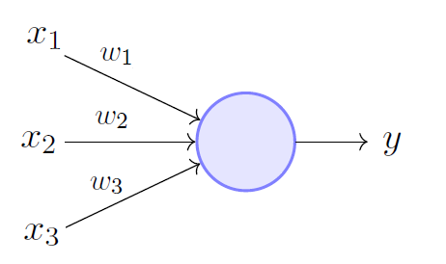
Neurons and Perceptrons
The Simplest Neural Network
Now that we understand how a neuron works, let's introduce the perceptron—the simplest form of a neural network.
The perceptron is essentially a single-layer neural network. It consists of one or more inputs connected to an output via weights, and it makes binary decisions based on those inputs.

Slide 25
Neurons and Perceptrons
Mathematical Representation of a Perceptron
Let’s break down the perceptron step-by-step
1. Inputs and Weights
Similar to an individual neuron, the perceptron receives inputs (𝑥1,𝑥2,...,𝑥𝑛) and assigns each input a weight (𝑤1,𝑤2,...,𝑤𝑛).

Slide 26
Neurons and Perceptrons
Mathematical Representation of a Perceptron
Let’s break down the perceptron step-by-step
2. Weighted Sum
The perceptron calculates the weighted sum of inputs :
Where 𝑏 is the bias term

Slide 27

Neurons and Perceptrons
Mathematical Representation of a Perceptron
Let’s break down the perceptron step-by-step
3. Activation Function
The perceptron applies an activation function to decide the output. In the basic perceptron model, the activation function is a step function, meaning the perceptron outputs
1 if the weighted sum is above a certain threshold (neuron "fires").
0 if the weighted sum is below the threshold (neuron "doesn't fire").
This can be expressed mathematically as :

Slide 28
Neurons and Perceptrons
Limitations of a Perceptron
The perceptron is powerful for basic tasks, but it has significant limitations
1. Linear Decision Boundaries
The perceptron can only classify linearly separable data, meaning it can only separate classes with a straight line (or plane, in higher dimensions). For example, it works well for problems like OR or AND logic gates, but it struggles with more complex tasks like the XOR problem (which cannot be separated by a straight line).

Slide 29
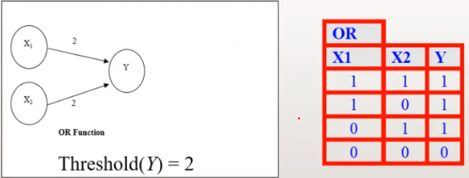
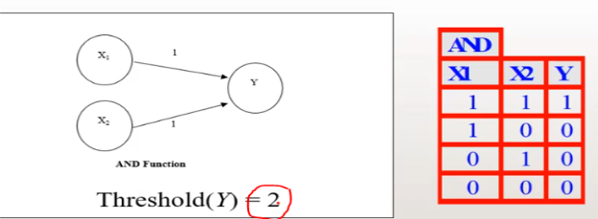
Neurons and Perceptrons
Limitations of a Perceptron
The perceptron is powerful for basic tasks, but it has significant limitations
1. Linear Decision Boundaries

Slide 30
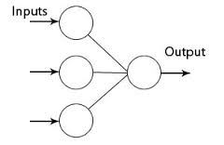
Neurons and Perceptrons
Limitations of a Perceptron
The perceptron is powerful for basic tasks, but it has significant limitations
2. No Hidden Layers
The basic perceptron has no hidden layers, which limits its ability to learn more abstract patterns. This leads us to the need for multi-layer networks to solve more complex problems, which we’ll cover later in feedforward neural networks.

Slide 31
Neurons and Perceptrons
From Perceptrons to Neural Networks
The perceptron is the building block for more complex neural networks. Here’s how
1. Multiple Layers
By stacking perceptrons together, we can create multi-layer neural networks (also known as multi-layer perceptrons or MLPs). Each layer builds on the output of the previous layer, allowing the network to learn more complex patterns in data.

Slide 32
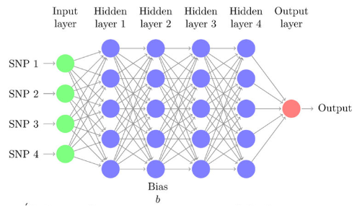
Neurons and Perceptrons
From Perceptrons to Neural Networks
1. Multiple Layers

Slide 33
Neurons and Perceptrons
From Perceptrons to Neural Networks
The perceptron is the building block for more complex neural networks. Here’s how
2. Non-Linear Activation Functions
Instead of a step function, modern neural networks use activation functions like ReLU (Rectified Linear Unit) or Sigmoid, which introduce non-linearity. This enables neural networks to model complex relationships and solve problems like XOR.

Slide 34
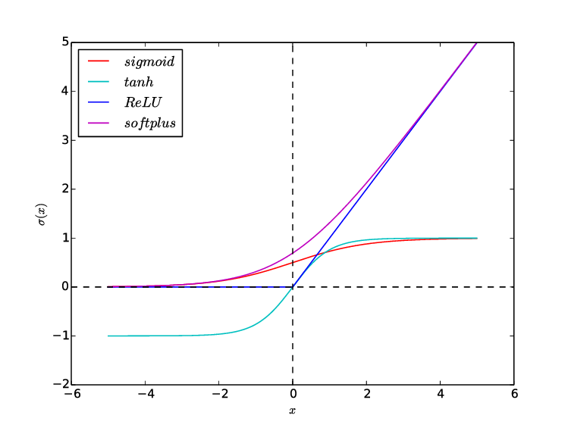
Neurons and Perceptrons
From Perceptrons to Neural Networks
2. Non-Linear Activation Functions

Slide 35

Neurons and Perceptrons
Activation Functions Overview
Activation functions play a crucial role in modern neural networks. Here’s a quick overview of commonly used functions
1. Sigmoid Activation Function
Outputs values between 0 and 1.
Often used in the output layer for binary classification problems.

Slide 36

Neurons and Perceptrons
Activation Functions Overview
Activation functions play a crucial role in modern neural networks. Here’s a quick overview of commonly used functions
2. ReLU (Rectified Linear Unit)
Outputs 0 if the input is negative, otherwise returns the input value.
Popular for hidden layers due to its simplicity and effectiveness.

Slide 37

Neurons and Perceptrons
Activation Functions Overview
Activation functions play a crucial role in modern neural networks. Here’s a quick overview of commonly used functions
3. Tanh Activation Function
Outputs values between -1 and 1.
Often used in hidden layers.

Slide 38
Neurons and Perceptrons
Summary and Key Takeaways
A neuron in artificial neural networks is a mathematical model that processes input data and produces an output based on the weighted sum of inputs and an activation function.
The perceptron is the simplest form of a neural network, performing binary classification based on a step function.
While perceptrons are limited to linear decision boundaries, they provide the foundation for more complex neural networks by stacking layers and using non-linear activation functions.
Activation functions are critical in determining whether a neuron "fires" and can introduce non-linearity, allowing neural networks to learn more complex patterns.

Slide 39
Feedforward Neural Networks

Slide 40
Feedforward Neural Networks
Introduction to Feedforward Neural Networks (FNNs)
Now that we understand how a single neuron (or perceptron) works, let’s move on to Feedforward Neural Networks (FNNs), which are the foundation of deep learning models.
Feedforward Neural Networks are the simplest form of artificial neural networks where information moves in one direction only, from the input layer to the output layer.
FNNs consist of multiple layers
Input Layer: Receives input data (features).
Hidden Layers: Process the input data using learned weights. These layers are where the network "learns" patterns.
Output Layer: Produces the final prediction or classification based on the processed data.

Slide 41
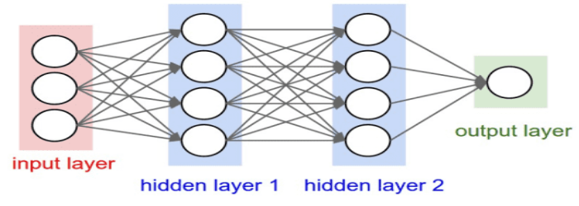
Feedforward Neural Networks
Architecture of a Feedforward Neural Network

Slide 42
Feedforward Neural Networks
Architecture of a Feedforward Neural Network
1. One-way Data Flow
In a feedforward neural network, data flows strictly in one direction—from the input layer to the output layer. There are no loops or feedback connections, meaning that information is only passed forward through the layers, never backwards. Once the input is received, it passes through each hidden layer sequentially until it reaches the output layer, where the final prediction is made.

Slide 43
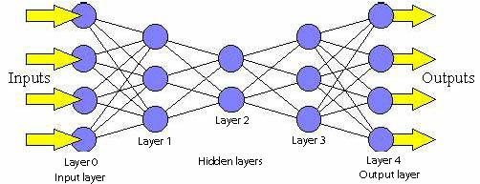
Feedforward Neural Networks
Architecture of a Feedforward Neural Network
1. One-way Data Flow

Slide 44
Feedforward Neural Networks
Architecture of a Feedforward Neural Network
2. Fully Connected Neurons
Each neuron in one layer is connected to every neuron in the previous layer. This is called a fully connected layer. Every neuron takes input from all the neurons in the previous layer and sends its output to every neuron in the next layer. This ensures that the network can fully utilize all information coming from previous layers to compute its next set of outputs.

Slide 45
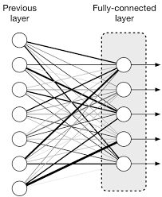
Feedforward Neural Networks
Architecture of a Feedforward Neural Network
2. Fully Connected Neurons

Slide 46
Feedforward Neural Networks
Architecture of a Feedforward Neural Network
3. Neuron Operations
Inside each neuron, the following steps occur
Input and Weights: The neuron receives inputs from the previous layer. Each input is multiplied by a weight, which controls how much influence that input has on the neuron’s output. These weights are adjusted during training.
Bias Addition: A bias term is added to the weighted sum. Bias allows the network to shift the activation function, which helps improve the model's flexibility.

Slide 47
Feedforward Neural Networks
Architecture of a Feedforward Neural Network
3. Neuron Operations
Inside each neuron, the following steps occur
Activation Function: The neuron applies an activation function to the weighted sum + bias. This introduces non-linearity to the model, enabling it to learn complex relationships in the data. Common activation functions include ReLU, Sigmoid, and Tanh.
Output: The result of the activation function is passed as the output of that neuron, which becomes the input for neurons in the next layer.

Slide 48
Backpropagation and Gradient Descent

Slide 49
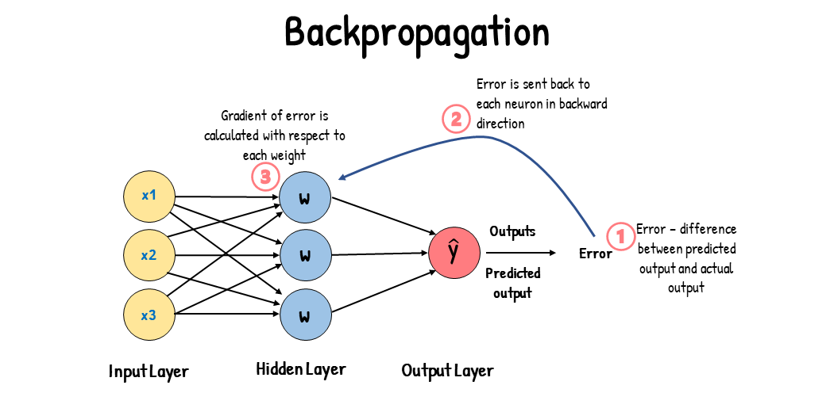
Backpropagation and Gradient Descent
Backpropagation and Gradient Descent are essential techniques for training neural networks. Together, they allow a network to learn from data by adjusting the model's weights and biases to minimize errors and improve predictions.

Slide 50
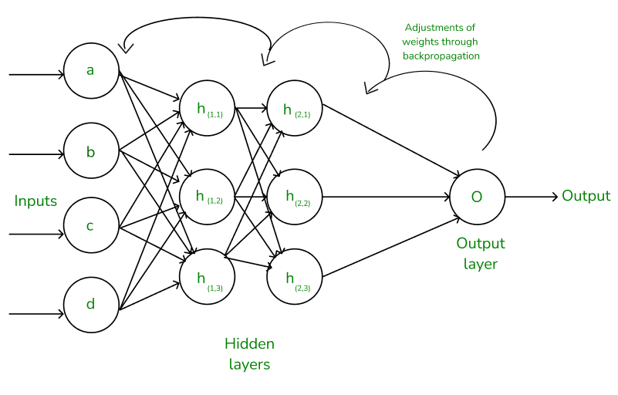
Backpropagation and Gradient Descent
What is Backpropagation?
Backpropagation is a method used in training neural networks to calculate the gradient of the loss function with respect to each weight in the network. It enables the network to adjust the weights and biases in order to reduce the prediction error over time.

Slide 51
Backpropagation and Gradient Descent
Key Steps in Backpropagation
Forward Pass: The network makes a prediction using the current weights and biases by calculating outputs at each layer (this is called the forward pass)
Compute Loss: The loss (or error) is computed by comparing the network’s prediction (output) to the actual target using a loss function (e.g., Mean Squared Error for regression or Cross-Entropy for classification).
Backward Pass: Using the chain rule of calculus, the error is propagated backward through the network to compute how much each weight contributed to the error. This backward process gives us the gradients of the loss with respect to each weight.

Slide 52
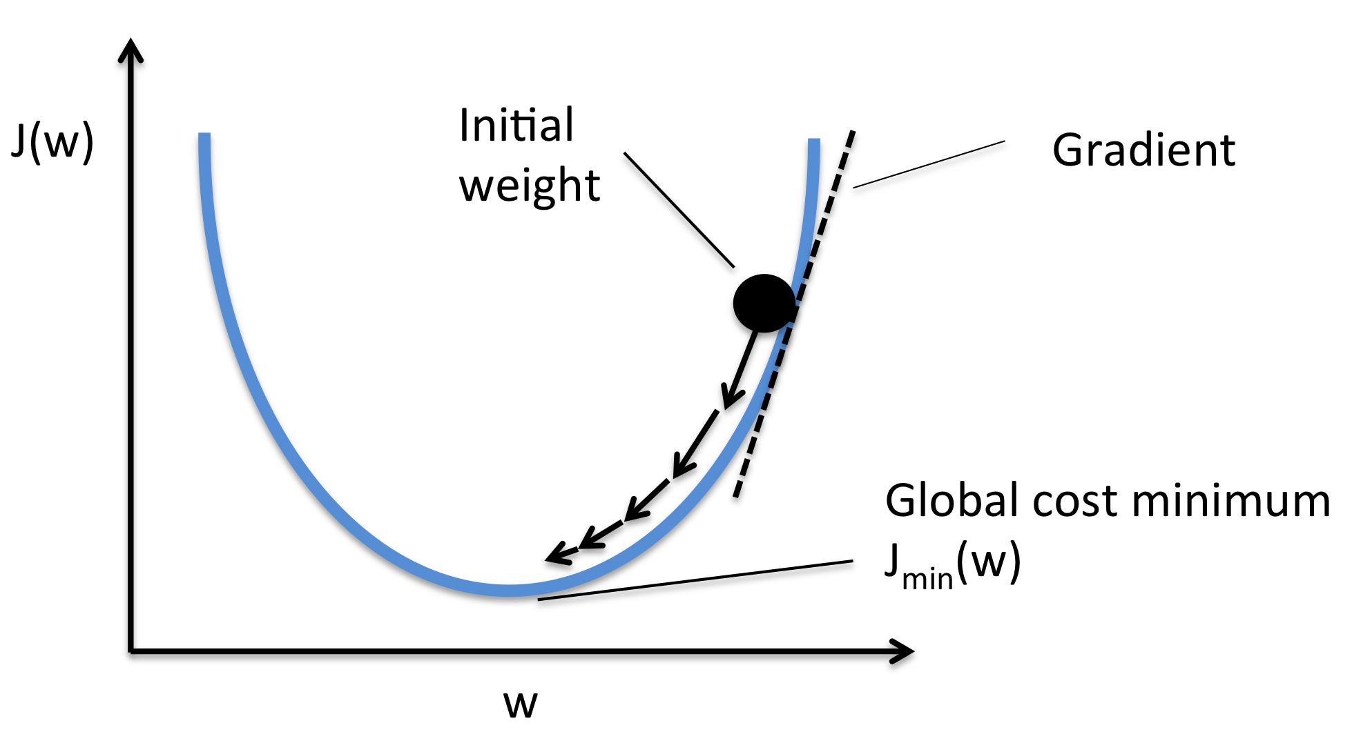
Backpropagation and Gradient Descent
What is Gradient Descent?
Gradient Descent is an optimization algorithm used to minimize the loss function. The idea is to find the set of weights and biases that minimize the error. This is done by updating the weights and biases in the direction that reduces the loss.

Slide 53
Backpropagation and Gradient Descent
How Gradient Descent Works
1. Compute Gradient
In the backward pass, we calculate the gradient of the loss function with respect to each weight and bias.

Slide 54

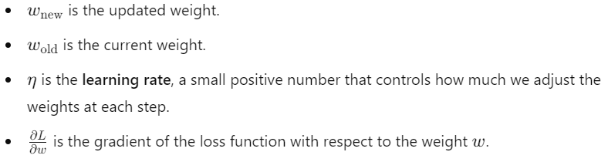
Backpropagation and Gradient Descent
How Gradient Descent Works
2. Update Weights
After obtaining the gradients, the weights are updated using the gradient descent rule :
Where :

Slide 55

Backpropagation and Gradient Descent
How Gradient Descent Works
3. Repeat
This process is repeated for each layer of the network during training. As the network sees more data, the weights and biases are continually updated, and the loss decreases, leading to better predictions.

Slide 56
Backpropagation and Gradient Descent
How Backpropagation and Gradient Descent Work Together
Backpropagation and Gradient Descent complement each other in training a neural network. Here’s how they fit together
Forward Pass: The network makes a prediction, and we calculate the loss (error).
Backward Pass (Backpropagation): The error is propagated backward through the network to compute the gradients (partial derivatives) of the loss with respect to each weight and bias.
Weight Update (Gradient Descent): The weights are updated using the gradients, pushing them in the direction that reduces the loss.
Repeat: The process is repeated over many iterations (or epochs) until the model converges, meaning that the loss function reaches a minimum.

Slide 57
Backpropagation and Gradient Descent
How Backpropagation and Gradient Descent Work Together
Let’s walk through a simple example with a small neural network
1. Forward Pass
Inputs: 𝑥1,𝑥2
Weights: 𝑤1,𝑤2
Bias: 𝑏
The output is calculated: and passed through the activation function to get 𝑦 pred.

Slide 58
Backpropagation and Gradient Descent
How Backpropagation and Gradient Descent Work Together
Let’s walk through a simple example with a small neural network
2. Compute Loss
We compare the predicted output 𝑦 pred with the actual target 𝑦 actual using a loss function like Mean Squared Error.

Slide 59
Backpropagation and Gradient Descent
How Backpropagation and Gradient Descent Work Together
Let’s walk through a simple example with a small neural network
3. Backpropagation
We calculate the gradient of the loss with respect to 𝑤1,𝑤2,𝑏
This gives us the direction in which we need to adjust the weights and bias to reduce the loss.

Slide 60
Backpropagation and Gradient Descent
How Backpropagation and Gradient Descent Work Together
Let’s walk through a simple example with a small neural network
4. Gradient Descent
Using the gradients, we update the weights and biases :

Slide 61
Backpropagation and Gradient Descent
How Backpropagation and Gradient Descent Work Together
Let’s walk through a simple example with a small neural network
5. Repeat
We repeat the forward pass, loss calculation, backpropagation, and weight update steps until the model converges to a minimum loss.

Slide 62
Backpropagation and Gradient Descent
Key Takeaways
Backpropagation computes the gradients (derivatives) of the loss with respect to each weight by applying the chain rule. This allows the network to understand how each weight contributes to the error.
Gradient Descent uses these gradients to update the weights, reducing the error step by step, in the direction of minimizing the loss.
Together, backpropagation and gradient descent form the core of the training process for neural networks, allowing the model to learn from data and improve its performance.

